Slide 1
Front-end
Back-end
Xcode
Swift
Firebase
CocoaPods
Sketch
iOS Speech
Recognition API

Slide 3
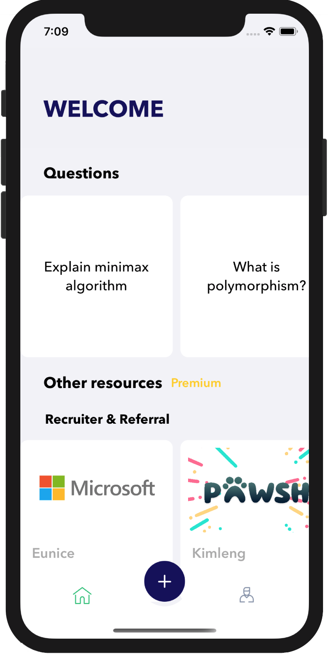
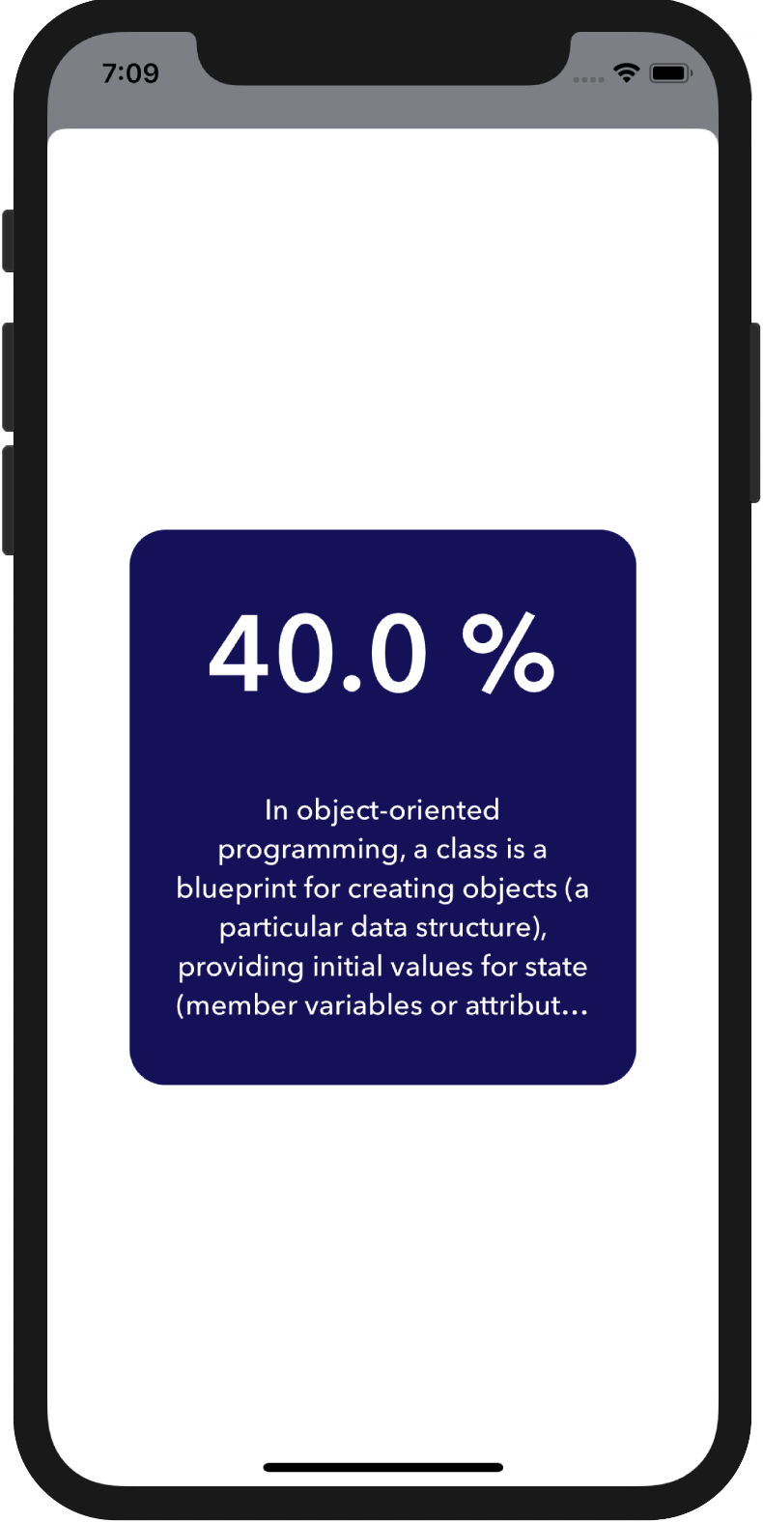
Speech
recognition
Speech to
text
Add to
Firebase
Extract
keywords
Compare with current answer
Query
Best answer
Type a
question

Slide 4
Add Question
Type a
question

Slide 5
Add Answer
Speech
recognition
Speech to
text
Add to
Firebase
Extract
keywords
Add keywords into
current answer
Notes:
Add contribute answer

Slide 6
Quiz Yourself
Speech
recognition
Speech to
text
Add to
Firebase
Extract
keywords
Compare
with
current answer
Query
Best answer
Notes:
Quiz yourself

